Slide 1
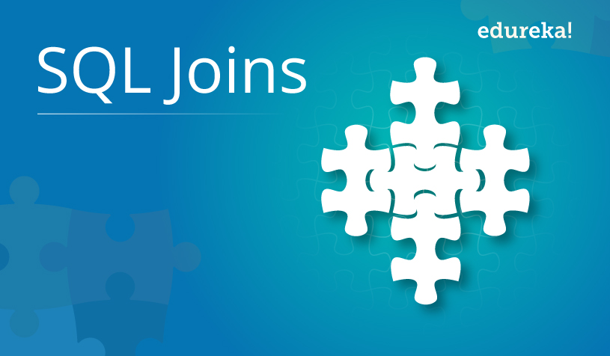
SQL JOINS

Slide 2
What is SQL Join? And his type
❖ JOIN clause combines rows from two or more tables. ❖ creates a set of rows in a temporary table.
1 .Inner join
2.left join
3.right join
4.full join

Slide 3
1.Inner join
Inner join means to select a record that have same matching a values of both table.
INNER JOIN Syntax
SELECT column_name(s) FROM table1 INNER JOIN table2 ON table1.column_name = table2.column_name;

Slide 4
2. Left Join:-
Left joins means we have to select the all record in left table(table1) and matching the record of right table(table2).so the result is zero then we say no match.
Sometimes is called left outer join.
LEFT JOIN Syntax
SELECT column_name(s) FROM table1 LEFT JOIN table2 ON table1.column_name = table2.column_name;

Slide 5
3.Right join
Right join means we have to select a record of right side table(table 2)and match the table first that is left side table(table1).then the result is zero then we say there is no match.
Sometime is called a right outer join.
RIGHT JOIN Syntax
SELECT column_name(s) FROM table1 RIGHT JOIN table2 ON table1.column_name = table2.column_name;

Slide 6
4.Full Outer join
The full outer join menas we have to give a all records of left table and right table that is table(1) and table(2).
Here the full outer join and outer join is same.
FULL OUTER JOIN Syntax
SELECT column_name(s) FROM table1 FULL OUTER JOIN table2 ON table1.column_name = table2.column_name WHERE condition;

Slide 7


